Slide 1
Software Project Management
In the name of Allah, the Beneficent, the Merciful
Lecture 11:
Quality Management

Slide 2

What is Quality ?

Slide 3

What is Quality?
Customer
The software you create lives up to expectations, is reliable, and does some incredible things the customer doesn’t expect (or even think of).

Slide 4

What is Quality?
Project Team
The work is completed as planned and as expected, with few errors - and fewer surprises.

Slide 5

What is Quality?
Managers
The customer is happy and the project delivers on time and on budget.

Slide 6
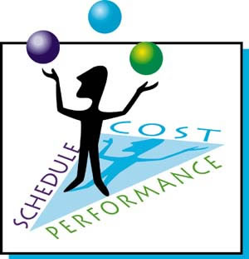
What is Quality?
Project Manager
The project team completes its work according to its estimates, the customer is happy, and management is happy with the final costs and schedule.

Slide 7
What is Quality?
Quality, for everyone concerned, is the ability of the project and the project’s deliverable to satisfy the stated and implied requirements.
For this, you can refer to:
Product Scope
Project Scope

Slide 8
Product Scope
The product scope describes, lists, and categorizes all the features and components of the finished deliverable.

Slide 9
Product Scope
In order to satisfy the product scope, you will need following documents:
Product Scope Description – What Customer Expects
Requirement Document – Defines Exactly What Project Must Create
Detailed Design Document – Specifies How Project Team Will Create Units
Metrics For Acceptability – Speeds, Data Accuracy, User Acceptability, etc

Slide 10
Project Scope
The project scope describes the work (and only the required work) that must be completed in order to complete the project.
The project scope defines what will and won’t be included in the project deliverable.

Slide 11
Project Scope Statement
Deliverables e.g., defines what the project will create for the customer
Assumptions e.g., you’ll have access to test the software on customer’s network
Exclusions e.g., you are not responsible for initial data entry
Influences e.g., business processes, other applications, departments

Slide 12
Avoid Gold Plating
Gold plating is the process of adding extra features that may drive up costs and alter schedule.
The project team should strive to deliver what was expected.

Slide 13
What is Grade?
Grade is the ranking or classification we assign to things.

Slide 14
Quality vs Grade
Example: Windows OS
Grade is different versions of “Windows OS” (i.e., Personal, Business, Enterprise)
Quality, is the ability of “Windows OS” to deliver on its promises.

Slide 15
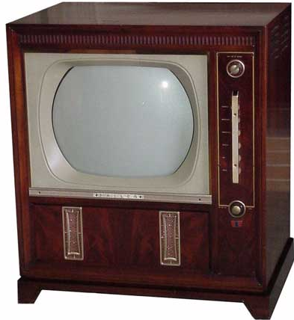
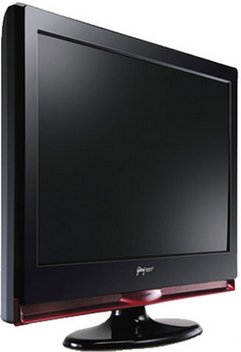
Quality vs Grade
Which of these two television would you like - LCD TV or the good old CRT television of the 80's?

Slide 16
Quality vs Grade
If you opted for LCD TV, you probably chose it over the CRT TV because of its superior grade.
And that makes the CRT TV to be of low grade. Right?

Slide 17

Quality vs Grade
Now, you are given a choice between this LCD TV and an ultra slim LED 3D TV. What would you choose?

Slide 18
Quality vs Grade
The same LCD TV now feels low grade when compared to the brand new LED 3D TV!
Grade is a measure of the value people place on the product.

Slide 19
Quality vs Grade
Know that low quality is always a problem, but low grade may not be.
Depending on the requirements of the customer, low grade may be completely acceptable, but low quality never is.

Slide 20
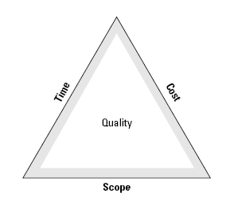
Balancing Iron Triangle
Doesn’t mean creating 100% bug free or creating an ultimate solution

Slide 21
How do you know an error exists?
Testing
Complete peer reviews
Hire third parties to examine your code

Slide 22
Testing
Unit testing tests each individual component to ensure it is as defect-free as possible.
Integration testing occurs between unit and system testing to test functionally grouped components.
System testing tests the entire system as one entity.
User acceptance testing is an independent test performed by end users prior to accepting the delivered system.

Slide 23
How much quality is enough?
If your organization spends months or years examining, inspecting, and testing code, the market window can easily open and shut for your software

Slide 24
How much quality is enough?
For example,
you rank the bugs you’ve identified from 1 to100, with 100 being the most severe.
Any bugs below a score of 20 may be accepted for now, while everything over 20 needs to be fixed.

Slide 25
Optimal Quality
Optimal Quality describes how much quality is expected in return for the cost to achieve that level of quality.

Slide 26
Optimal Quality
Optimal Quality describes how much quality is expected in return for the cost to achieve that level of quality.
Cost
Price / Copy of Software
Number of Buyers
Gross Profit = Price x Buyers
Net Profit = Gross Profit – Cost

Slide 27
Optimal Quality
Optimal quality has two related costs for you to consider:
Cost of Quality (e.g., planning, testing, quality assurance, etc)
Cost of Nonconformance To Quality (e.g., rework, unhappy customers, low sales, etc)

Slide 28
Cost Categories Related to Quality
Prevention cost: Cost of planning and executing a project so it is error-free or within an acceptable error range.
Appraisal cost: Cost of evaluating processes and their outputs to ensure quality.
Internal failure cost: Cost incurred to correct an identified defect before the customer receives the product.
External failure cost: Cost that relates to all errors not detected/corrected before delivery to the customer.
Measurement and test equipment costs: Capital cost of equipment used to perform prevention and appraisal activities.

Slide 29
Quality Policy
A quality policy is an organization-wide policy that dictates how your organization will plan, manage, and then control quality in all projects.

Slide 30
Who Decides Project Quality?
You might guess and say the customer, which to some extent is true, but generally the quality policy is set by management.

Slide 31
Determining Quality Policy
Formal Approaches:
ISO 9000, ISO 15504
CMMI
Total Quality Management (TQM)
Six Sigma
In-House Quality Policy

Slide 32
Q & A

